Slide 1
Computer Organization and Assembly Language
For 8086 Processor

Slide 2
Marks Distribution for This course
Mid Term | Final Term | Quiz's | Assignments | Attendance | Class Participation /Each class assignment | Lab | Mini Project
20 | 40 | 10 | 5 | 5 | 5 | 10 | 5
No any copied Assignments will Accepted.
Pair of two students will Make project together.
3 Grace Marks will given according to the Class performance.

Slide 3
Books
Assembly Language Programming and Organization of The IBM PC by Ytha YU Charles Marut.
Assembly Language for X86 Processors seventh Edition by Kip R. Irvine

Slide 4
Computer Organization
Introduction

Slide 5
Microcomputer System
Microcomputer system, consisting of a system unit, a keyboard, a display screen, and disk drives.
The system unit is often referred to as "the computer," because It houses the circuit boards of the computer.
The keyboard, display screen, and disk drives are called I/0 devices because they perform input/output operations for the computer. They are also called peripheral devices or peripherals.
Integrated-circuit (IC) chips are used in the construction of computer circuits. ·
Each (IC) chip contain hundreds or even thousands of transistors.

Slide 6
Cont.
These IC circuits arc known as digital circuits
because they operate on discrete voltage signal levels, typically, a high voltage and a low voltage.
We use the symbols 0 and 1s to represent the low- and high-voltage signals,
These symbols are called binary digits, or bits.
All information processed by the computer is represented by strings of O's and l's; that is, by bit strings. . ·

Slide 7
Components of a Microcomputer System
Functionally, the' computer circuits consist of three parts:
CPU
Memory
I/O Circuits

Slide 8
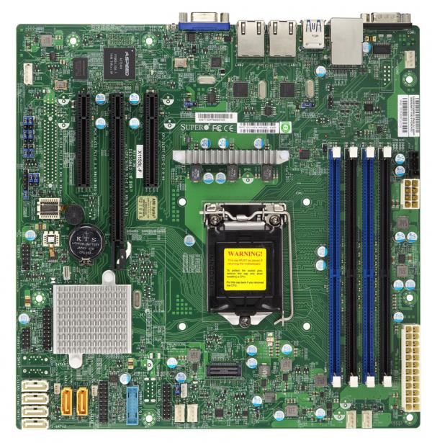
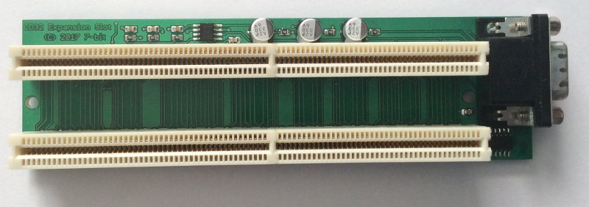
The System Board
Inside the System unit is a main circuit board called the system board.
Which contains the microprocessor and memory circuits.
It is also called Motherboard.
Because it contains expansion slots which are connectors for additional circuit boards called add-in boards or add in cards. such as video, sound, advanced graphics, Ethernet or memory.
I/O circuits are usually located on add-in cards

Slide 9
Memory
Each memory byte for short is identified by a number that is called its address.
The first memory byte has address depends on the processor.
For example , the Intel 8086 microprocessor assigns a 20bit address , and the Intel 80286 microprocessor uses a 24-bit address.
The data stored in a memory is its content.
Information processed by the computer is stored in its memory.
A memory circuit element can store one bit of data.
A memory circuit also organized into groups that can store 8 bits of data and strings of eight bits is called byte.

Slide 10
Example
Suppose a processor uses 20bit for an address. How many memory bytes can be accessed.
Solution: A bit can have two possible values.
, so in a 20-bit address there can be 2²° =1048576 different values,
with each value being the potential address of a memory byte.
In computer terminology , the number 2²° is called 1 megabyte.
Thus , a 20-bit address can be used to address 1 megabyte or 1MB

Slide 11
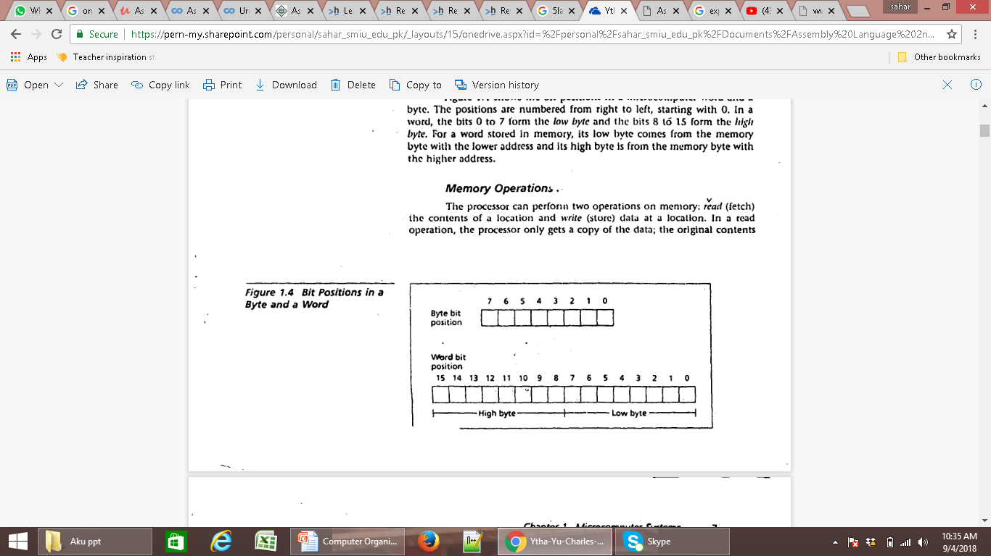
Bit Position of a byte and word
The positions are numbered
from right to left, starting
With 0.
In a word, the bits 0 to 7 form
the low byte and the bits 8
to 15 form the high byte.
For a word stored in memory,

Slide 12
Memory Operation
In a read operation , the processor only gets a copy of the data ; the original contents of the location are unchanged
The data written become the new contents of the location; the original contents are thus lost.
The processor can perform two operations.
Read( fetch) : the contents of a location and write (store) data at a location.

Slide 13
Two kinds of Memory circuits
RAM
ROM
RAM Locations can be used read and written,
Data is lost when machine is turned off
ROM location can only be read
Contents of ROM memory , once initialized , cannot be changed.
Retain their values even when the power is off.

Slide 14
Buses: A processor communicates with memory and I/O circuits by using signals that travels along set of wires or connections called buses that connect the different components.
Address bus
Data bus
And it receives data , sent by the memory circuit on the data bus.
Control signal
A control signal is required to inform the memory to perform a read operation.
The CPU sends the control signal on the control bus.
To read the contents of a memory location,
The CPU places the address of the memory location on the address bus,

Slide 15
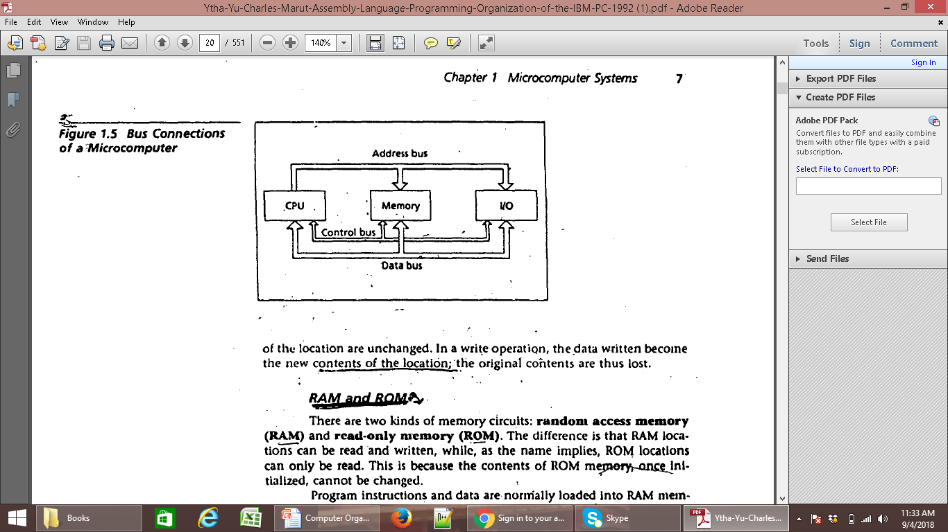

Slide 16
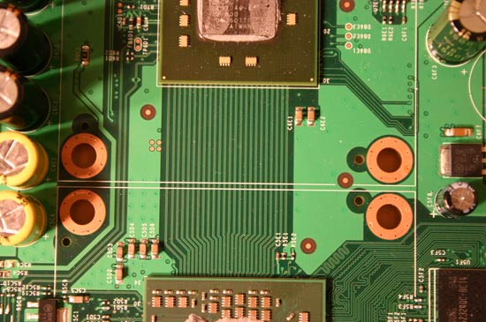
Bus
No of lines in bus affects the speed at which the data travels between different components
Parallel group of lines

Slide 17
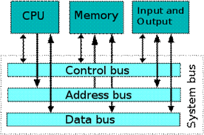
Which bus is unidirectional bus ?

Slide 18
Which bus is unidirectional bus ?
Address bus is Unidirectional because the microprocessor is addressing a specific memory location.
No outside devices can not write into Microprocessor.
Data bus is Bidirectional because the Microprocessor can read data from memory or write data to the memory.
Normally Control bus is unidirectional.

Slide 19
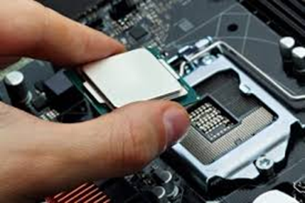
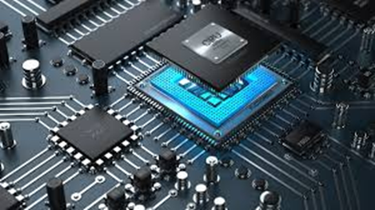
The CPU
Is the brain of the computer.
It controls the computer by executing programs stored in memory.
A programs might be a system program or an application program written by a use.
In any case , each instruction that the CPU executes is a byte.
The language of 0’s and 1’s is called machine language.

Slide 20
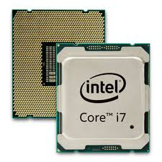
Microprocessor
Computer basic unit execute by Microprocessor.
It is in shape of chip made of semiconductor like silicon/ germanium .
it is combination of transistors.
This is basically IC ( Combination
of transistors.
Transistors: amplify the current from one place to another.
I
O
U

Slide 21

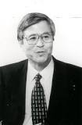

Father of Microprocessor
Marcian Hoff
Masatosi sema
Stanley Mazor
?

Slide 22
Evolution of Microprocessor
Intel 4004 (2300) 1971
Intel 8008(3500)
Intel 8080 (2300)
……..

Slide 23
The instruction performed by a CPU are called its instruction set.
And instruction set for each CPU is unique.
The Intel 8086 microprocessor as an example of CPU
There are two main components: the Execution unit and the bus interface unit

Slide 24
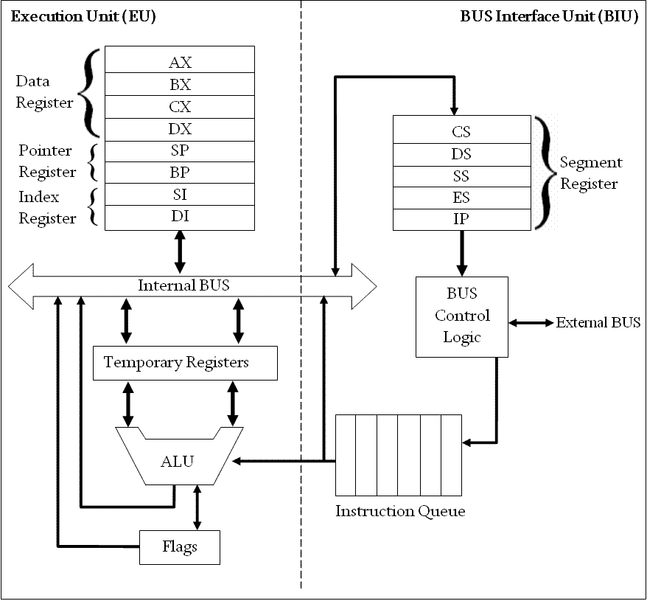

Slide 25
Execution unit (EU)
Bus Interface unit (BIU)
Its purpose is to execute instruction.
It contains ALU for performing arithmetic(+,-,*,/) and logic (AND, operation
The data for operation is stored in circuit called register.
It provide communication between EU and the memory or I/O circuit.
It is responsible to transmitting addresses ,data , and control signals on the buses.
It also contain the register which holds the address of memory location

Slide 27
The EU has 8 register for storing data these are: AX, BX, CX, DX, SI, DI,BP,SP.
EU contains temporary registers for holding operands for the ALU.
And the flag register whose individual bits reflect the result of a computation
These are DS, ES, SS, and IP.
The IP hold the address of the next instruction to be executed by the EU.
The EU and BIU connected by internal bus and they work together.

Slide 29
EU is executing an instruction ,
The BIU fetches up to six bytes of the next instruction and places them in the instruction queue.
This operation is called prefetch. The purpose is to speed up the processor.

Slide 31
If the EU needs to communicate with memory or I/O devices
The BIU suspends instruction prefetch and perform the needed operation.

Slide 32
Instruction Set
Machine instruction has two parts.
Opcode
Operands
Opcode specifies the types of operation, and the operands are specify the address of the data.

Slide 33
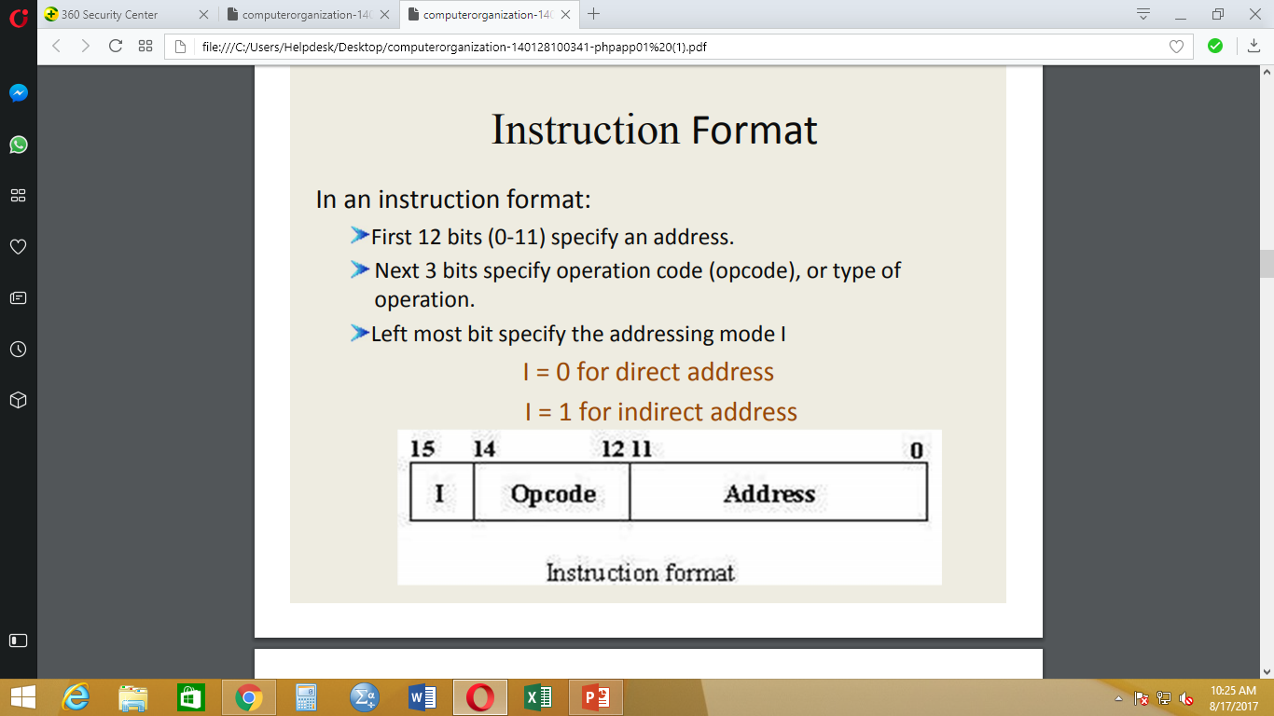

Slide 34
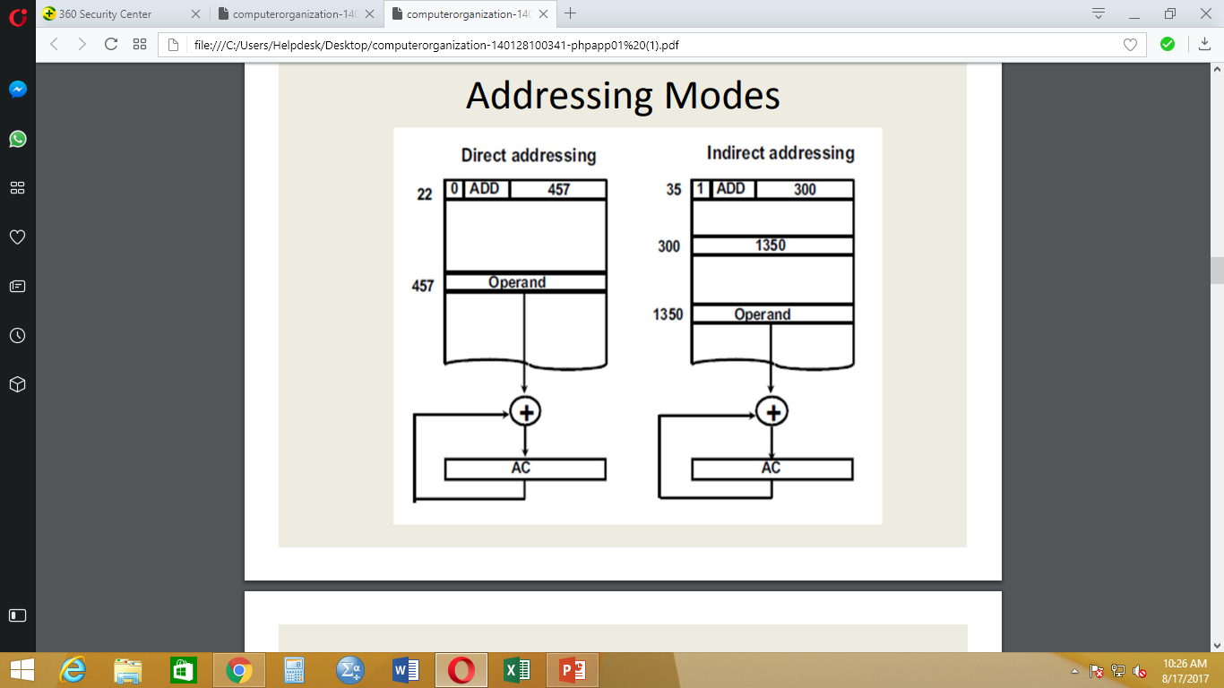

Slide 35
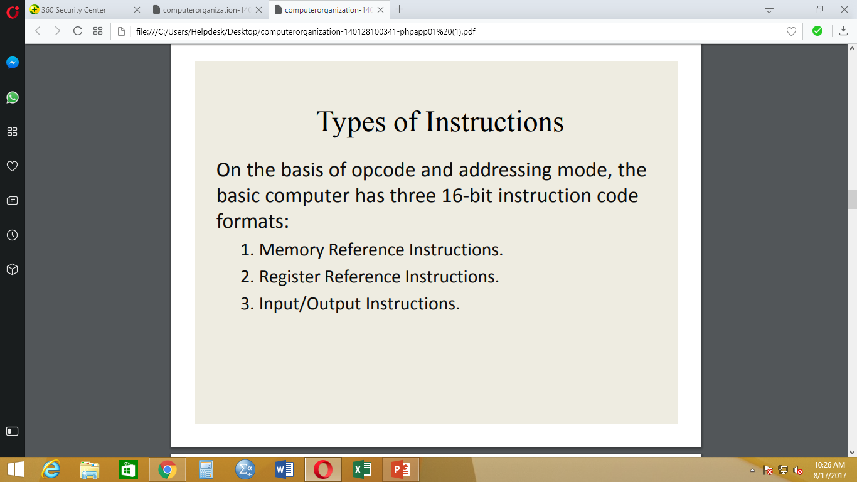

Slide 36
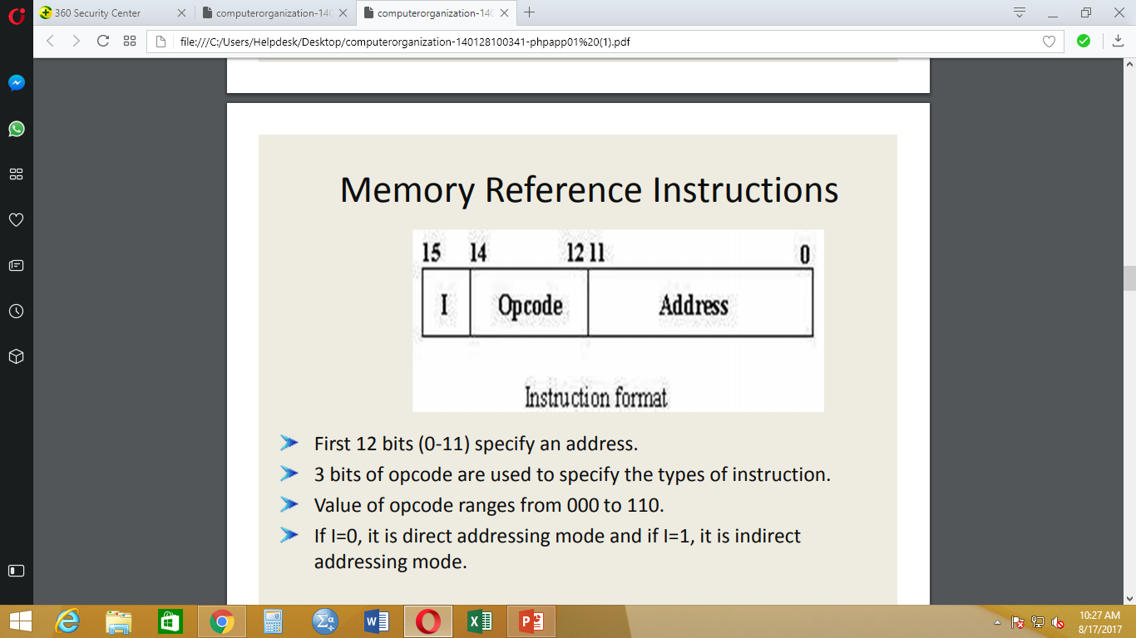

Slide 37
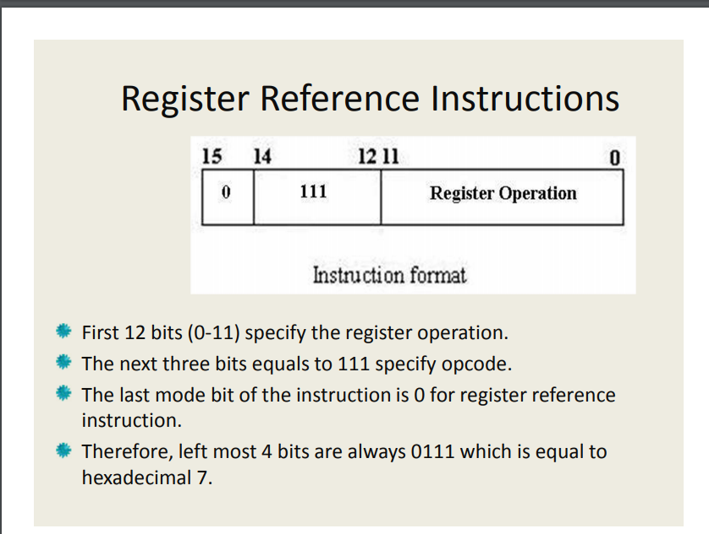

Slide 38
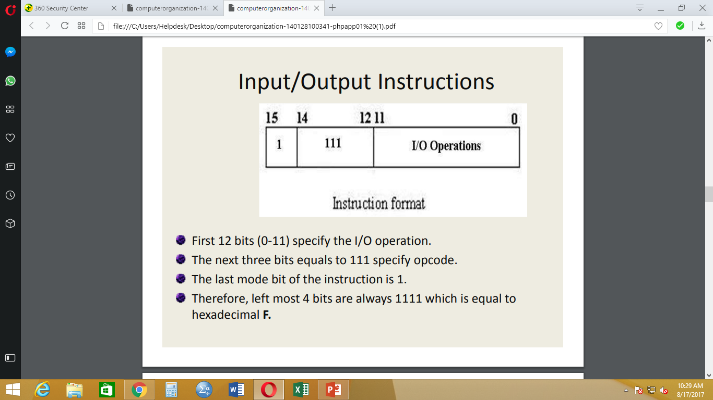

Slide 39
Cache Memory
Cache memory is used to increase the performance of the PC.
It holds data and instructions retrieved from RAM to provide faster access to the CPU.
As a computer system is built using components from different suppliers, there are no standards on the speeds and transfer rates of these components.
The CPU (processor) and main memory (RAM) overcome these differences by using cache memory.
Cache memory is an extremely fast memory type that acts as a buffer between RAM and the CPU. It holds frequently requested data and instructions so that they are immediately available to the CPU when needed.
Cache memory is located in two general locations: inside the processor (internal cache) and on the motherboard (external cache):

Slide 40
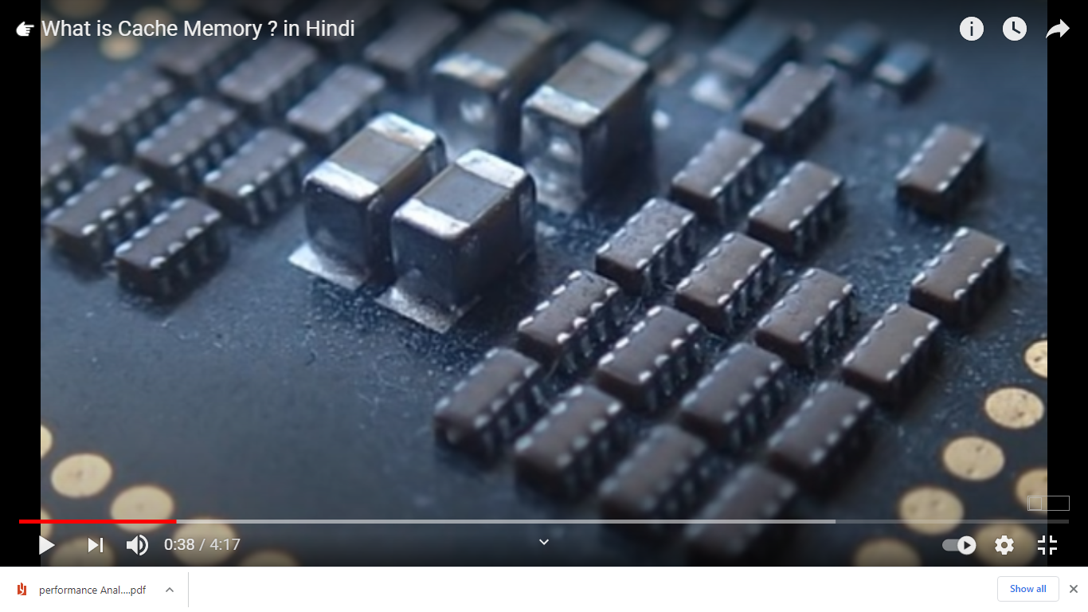

Slide 41
Types of Cache
Internal cache: also known as primary cache, internal cache is located inside the CPU chip.
External cache: also known as secondary cache, external cache is located on the motherboard outside the CPU. This is the cache referred to on PC specifications.

Slide 42
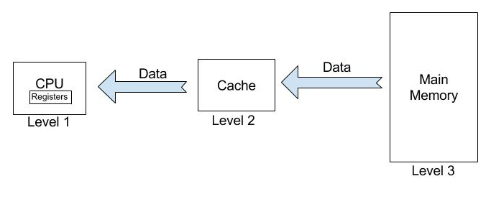

Slide 43
Cache
L1: smallest storage
Range 2kb to 64kb
Fastest Memory because close to CPU
L2 : Faster than l3
Slower than L1
Range 256 kb to 512 kb
L3: Largest than L1 and L2
Slowest than L1 and L2
Range 1MB to 8MB
Faster than RAM

Slide 44
How it work
L1 : pocket
L2 : Desk , beg
L3 : Home
Speed of processor can be improve with RAM , cache & processor.

Slide 45
Read given file about cache memory

